Slide 1
Neural Machine Translation
Cyrus M. Vahid,
AWS DeepLearning
cyrusmv@amazon.com

Slide 2
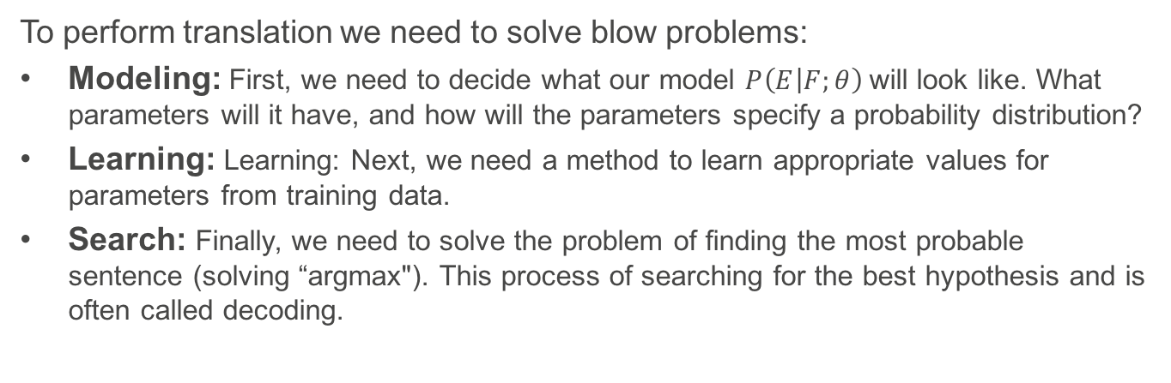
Problems of Translation
To perform translation we need to solve blow problems:
Modeling: First, we need to decide what our model $P\left(E | F;θ\right)$will look like. What parameters will it have, and how will the parameters specify a probability distribution?
Learning: Learning: Next, we need a method to learn appropriate values for parameters from training data.
Search: Finally, we need to solve the problem of finding the most probable sentence (solving “argmax"). This process of searching for the best hypothesis and is often called decoding.

Slide 3
Background Statistical Language Models

Slide 4
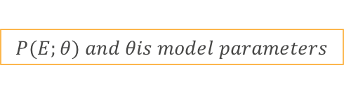
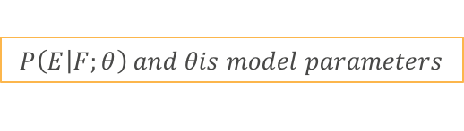
Machine Translation Statistical Prior
Machine Translation Task is predicting a sentence in a language, given another sentence in another language, more formally:
$$P\left(E | F;θ\right) and θis model parameters$$
The translation systems thus needs to be a language models itself, meaning being capable of building utterances that are naturally sounding, give a vocabulary. More formally:
$$P(E;θ) and θis model parameters$$

Slide 5
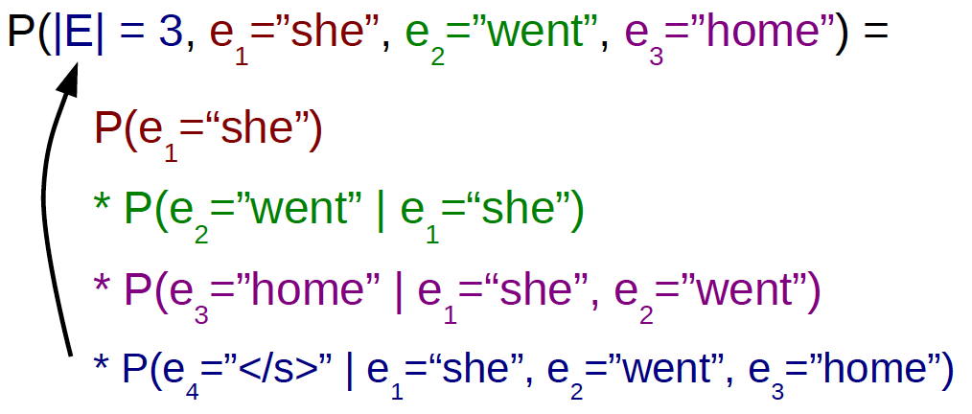
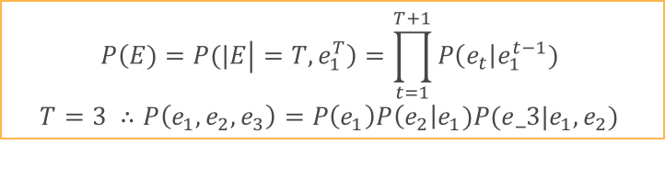
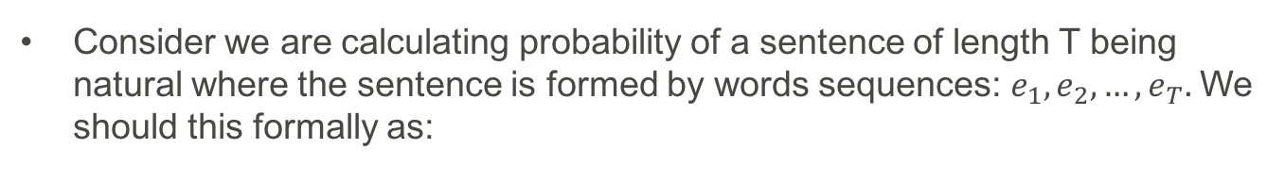
Word by Word Computation of Probabilities
Consider we are calculating probability of a sentence of length T being natural where the sentence is formed by words sequences: $e_{1}, e_{2}, …,e_{T}.$We should this formally as:
$$P\left(E)=P(|E | =T, e_{1}^{T}\right)=\prod_{t=1}^{T+1}{P\left(e_{t}\right|e_{1}^{t−1}) }$$
$$T=3 ∴P\left(e_{1},e_{2},e_{3}\right)=P\left(e_{1}\right)P\left(e_{2}\right|e_{1})P(e_3|e_{1},e_{2})$$

Slide 6
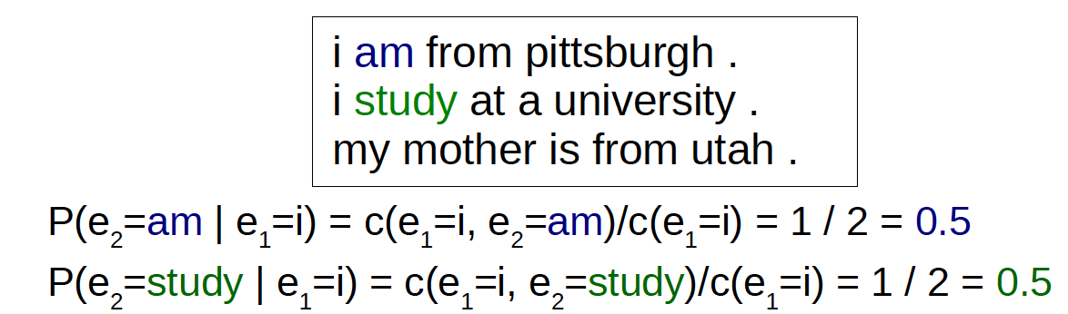
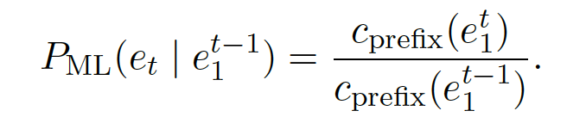
Count-Based n-gram Language Models
Prepare a set of training data from which we can count word strings
Count up the number of times we have seen a particular string of words
Divide it by the number of times we have seen the context.
More Formally:

Slide 7
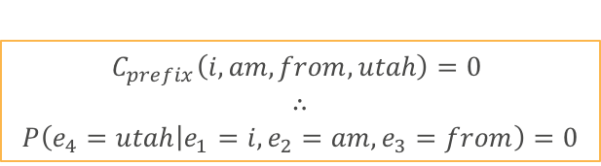
Count-Based n-gram LM – The Problem
If there is a sequence of four words such as ”I am from Utah” that does not exist in training set, then
$$C_{prefix}\left(i, am, from, utah\right)=0$$
$$∴$$
$$P\left(e_{4}=utah | e_{1}=i, e_{2}=am, e_{3}=from\right)=0$$

Slide 8
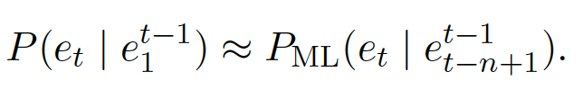
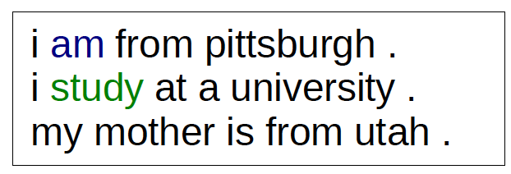
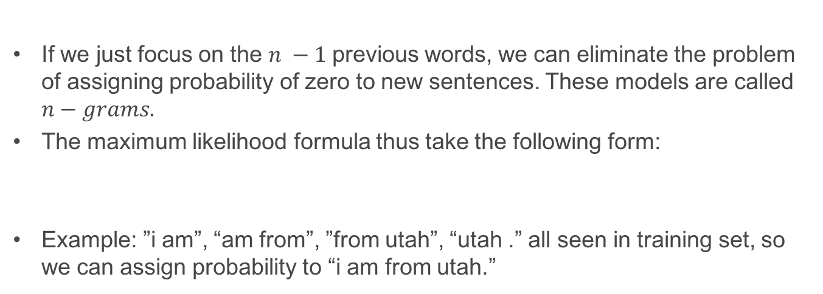
Count-Based n-gram LM – The Solution
If we just focus on the $n −1$previous words, we can eliminate the problem of assigning probability of zero to new sentences. These models are called $n−grams.$
The maximum likelihood formula thus take the following form:
Example: ”i am”, “am from”, ”from utah”, “utah .” all seen in training set, so we can assign probability to “i am from utah.”

Slide 9
Count-Based n-gram LM – The Problem Persists
In bigrams we have the same problem of assigning probability 0 if there is a sequence of 2 words that does not exist in training data
In trigams we have the same problem of assigning probability 0 if there is a sequence of 3 words that does not exist in training data.
…
In n-grams we have the same problem of assigning probability 0 if there is a sequence of n words that does not exist in training data

Slide 10
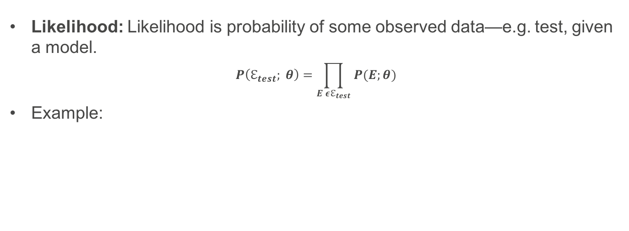
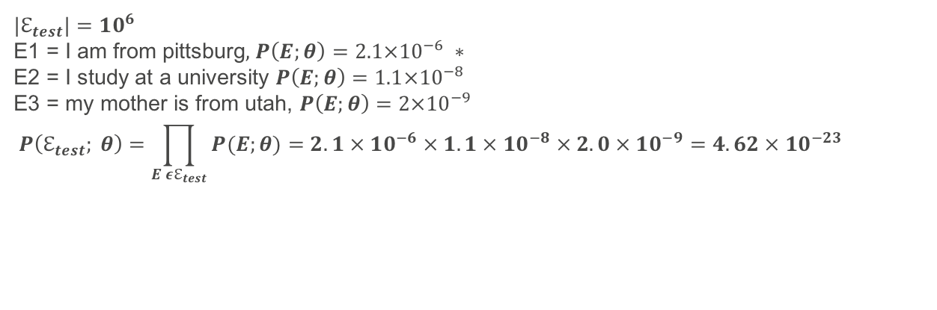
Evaluation of Accuracy - Likelihood
Likelihood: Likelihood is probability of some observed data—e.g. test, given a model.
$$P\left(ℇ_{test}; θ\right)=\prod_{E εℇ_{test}}{P(E;θ)}$$
Example:
$${|ℇ}_{test}|=10^{6}$$
E1 = I am from pittsburg, $P\left(E;θ\right)=2.1×{10}^{−6} ∗$
E2 = I study at a university $P\left(E;θ\right)=1.1×{10}^{−8}$
E3 = my mother is from utah, $P\left(E;θ\right)=2×{10}^{−9}$
$$P\left(ℇ_{test}; θ\right)=\prod_{E εℇ_{test}}{P(E;θ)}=2.1 × 10^{−6} × 1.1 × 10^{−8} × 2.0 × 10^{−9}=4.62 × 10^{−23}$$
*probabilities are arbitrary just to demonstrate the range

Slide 11
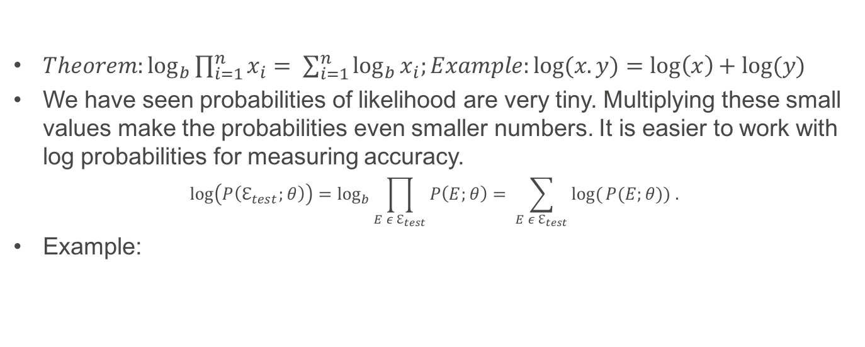
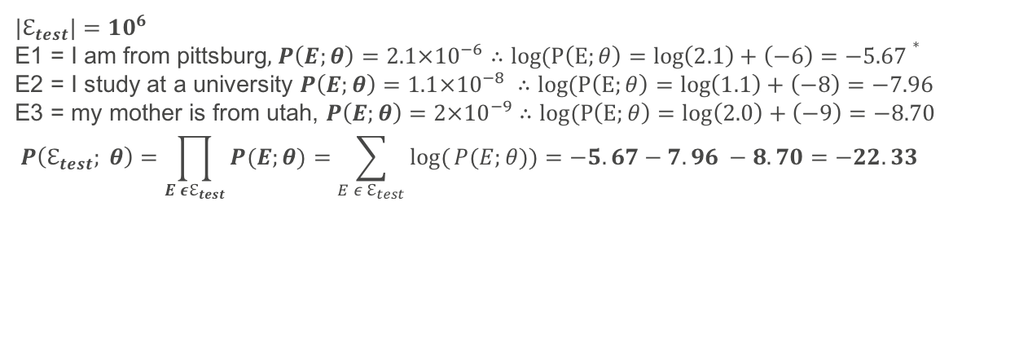
Evaluation of Accuracy – Log Likelihood
$Theorem:\log_{b}{\prod_{i=1}^{n}{x_{i}= \sum_{i=1}^{n}{\log_{b}{x_{i};Example:log⁡(x.y)=\log\left(x\right)+log⁡(y)}}}}$
We have seen probabilities of likelihood are very tiny. Multiplying these small values make the probabilities even smaller numbers. It is easier to work with log probabilities for measuring accuracy.
$$\log\left(P\left(ℇ_{test};θ\right)\right)=\log_{b}{\prod_{E ε ℇ_{test}}{P\left(E;θ\right)= \sum_{E ε ℇ_{test}}{log⁡(}P(E;θ)) .}}$$
Example:
$${|ℇ}_{test}|=10^{6}$$
E1 = I am from pittsburg, $P\left(E;θ\right)=2.1×{10}^{−6}∴log⁡(P\left(E;θ\right)=\log\left(2.1\right)+\left(−6\right)=−5.67∗$
E2 = I study at a university $P\left(E;θ\right)=1.1×{10}^{−8} ∴log⁡(P\left(E;θ\right)=\log\left(1.1\right)+\left(−8\right)=−7.96$
E3 = my mother is from utah, $P\left(E;θ\right)=2×{10}^{−9}$ $∴log⁡(P\left(E;θ\right)=\log\left(2.0\right)+\left(−9\right)=−8.70$
$$P\left(ℇ_{test}; θ\right)=\prod_{E εℇ_{test}}{P(E;θ)}=\sum_{E ε ℇ_{test}}{log⁡(}P(E;θ))=−5.67−7.96 −8.70=−22.33$$
*probabilities are arbitrary just to demonstrate the range

Slide 12
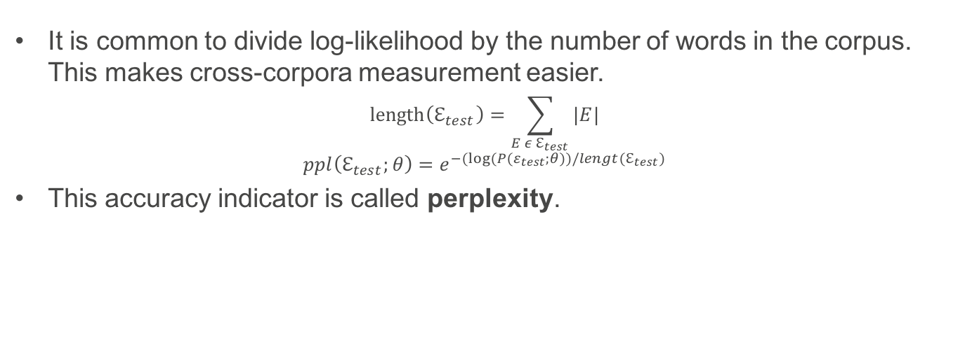
Evaluation of Accuracy – Perplexity
It is common to divide log-likelihood by the number of words in the corpus. This makes cross-corpora measurement easier.
$$length\left(ℇ_{test}\right)=\sum_{E ε ℇ_{test}}{|E|⁡}$$
$$ppl\left(ℇ_{test};θ\right)=e^{−(log⁡(P(ε_{test};θ))/lengt(ℇ_{test})}$$
This accuracy indicator is called perplexity.

Slide 13
Neural Language Models

Slide 14
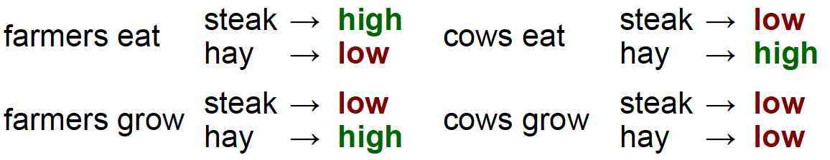
Motivation – MT and Context
In SMT is count-based and looses so much of hidden information.
There are other models such as log-linear where we actually include the context based on feature vectors, but we have other problems:
In separate contexts e_{t-2} = “farmers” is compatible with e_{t} = “hay” and e_{t-1} = “eats”.
If we are using feature sets depending on e_{t-1} and e_{t-2}, then a sentence like “farmers eat hey” cannot be ruled out, even though it is an unnatural sentence.
The solution is adding future combination that increases dimensionality. It is time to find a better solution

Slide 15
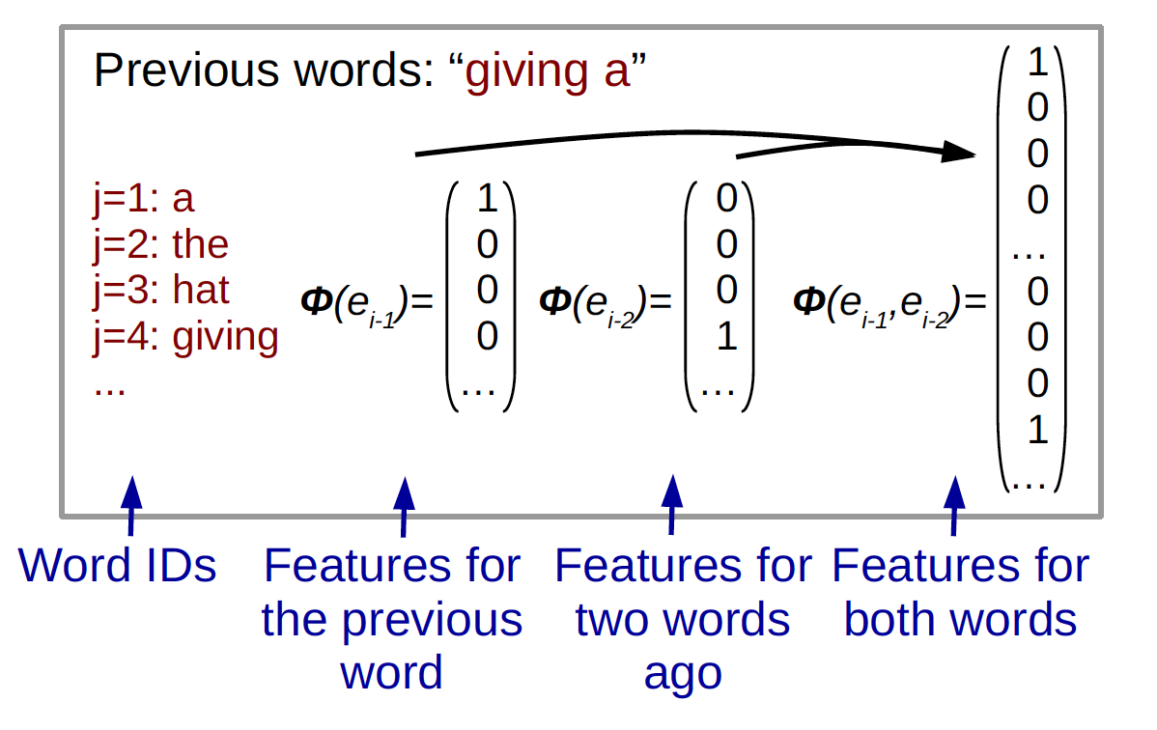
Step 1, Word Embedding
In Neural Language Models we represent words as word embedding, a vector representation of words.
Then we concatinate these words to the length of the context (3 for trigrams).

Slide 16
Step 1, Uncovering Combination Features
Different elements of a vector can potentially reflect different aspect of a word. For instance, different elements could represent countability, being and animal, …
We run the embedding vectors through hidden layer in order to learn combination features
https://www.tensorflow.org/tutorials/word2vec

Slide 17
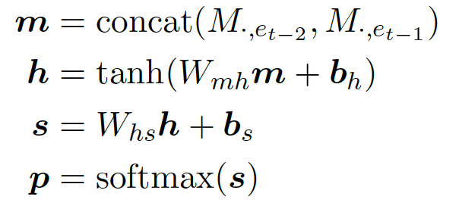
Step 3, Calculating Scores and Probability
Next, we calculate the score vector for each word. This is done by performing anaffine* transform of the hidden vector h with a weight matrix and adding a bias vector.
Finally, we get a probability estimate p by running the calculated scores through a softmax function.
* An affine transformation is any transformation that preserves collinearity (i.e., all points lying on a line initially still lie on a line after transformation) and ratios of distances (e.g., the midpoint of a line segment remains the midpoint after transformation). Ref: Wolfram Mathworld

Slide 18
Benefits of Neural Language Models
Better generalization of contexts: n-gram models treat words as independent entities. Word embedding allows grouping of similar words that perform similarly in prediction of the next word.
More generalizable combination of words into contexts: In an n-gram language model, we would have to remember parameters for all combinations of {cow; horse; goat} X {consume; chew; ingest} to represent the context of things farm animals eat". Hidden layer are more efficient in representing the concept.
Ability to skip previous words: n-gram models refer to all sequential words depending the length of the context. Neural Models can skip words.
Simplistic Models: SMT models require complex data-structures, in production often using 80 GBs or more of heap space. High quality NMT production models are generally less than 1 GB.

Slide 19
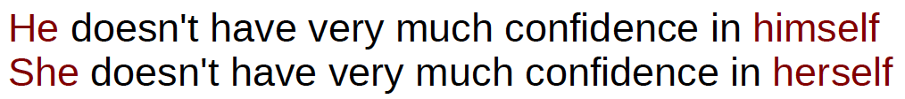
There is Still Something Missing…

Slide 20
There is Still Something Missing…
Seine steuerliche Bewertung wäre günstiger gewesen, wenn seine Steuererklärung ür das Geschäftsjahr 1927 früher überprüft worden wäre
His tax assessment would have been more favorable if his tax return for fiscal year 1927 had been checked earlier.

Slide 21
There is Still Something Missing…
Who?
Seine steuerliche Bewertung wäre günstiger gewesen, wenn seine Steuererklärung für das Geschäftsjahr 1927 früher überprüft worden wäre
His tax assessment would have been more favorable if his tax return for fiscal year 1927 had been checked earlier.

Slide 22
There is Still Something Missing…
Handling Long-Term Dependencies
Who?
Seine steuerliche Bewertung wäre günstiger gewesen, wenn seine Steuererklärung ür das Geschäftsjahr 1927 früher überprüft worden wäre
His tax assessment would have been more favorable if his tax return for fiscal year 1927 had been checked earlier.

Slide 23
Sequences and Long-Term Dependency
The Spanish King officially abdicated in … of his …, Felipe. Felipe will be confirmed tomorrow as the new Spanish … .

Slide 24
Sequences and Long-Term Dependency
The Spanish King officially abdicated in favour of his son, Felipe. Felipe will be confirmed tomorrow as the new Spanish King .
Reference

Slide 25
Sequences and Long-Term Dependency
Their duo was known as "Buck and Bubbles”. Bubbles tapped along as Buck played on the stride piano and sang until Bubbles was totally tapped out.
Context

Slide 26
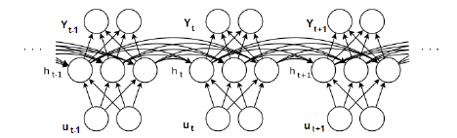
Sequences and Long-Term Dependency
CNN is news organization
CNN is short for Convolutional Neural Network
In our quest to implement perfect NLP tools, we have developed state of the art RNNs. Now we can use them to … .
Notes:
Recognize speech

Slide 27
Sequences and Long-Term Dependency
CNN is news organization
CNN is short for Convolutional Neural Network
In our quest to implement perfect NLP tools, we have developed state of the art RNNs. Now we can use them to wreck a nice beech. (Jeoffy Hinton – Coursera)
Register/Topic
Notes:
Recognize speech

Slide 28
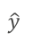
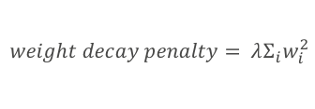
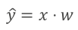
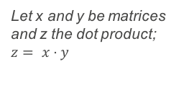
Computational Graphs
$$u^{(2)}$$
$$u^{(3)}$$
sum
x
z
$$\hat{y}$$
$$u^{(1)}$$
x
dot
sqr
x
y
x
w
$$λ$$
Let x and y be matrices and z the dot product; $z= x⋅y$
$$\hat{y}=x⋅w$$
$$weight decay penalty= λΣ_{i}w_{i}^{2}$$

Slide 29
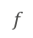
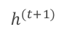
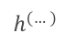
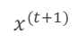
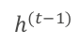
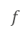
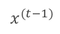
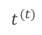
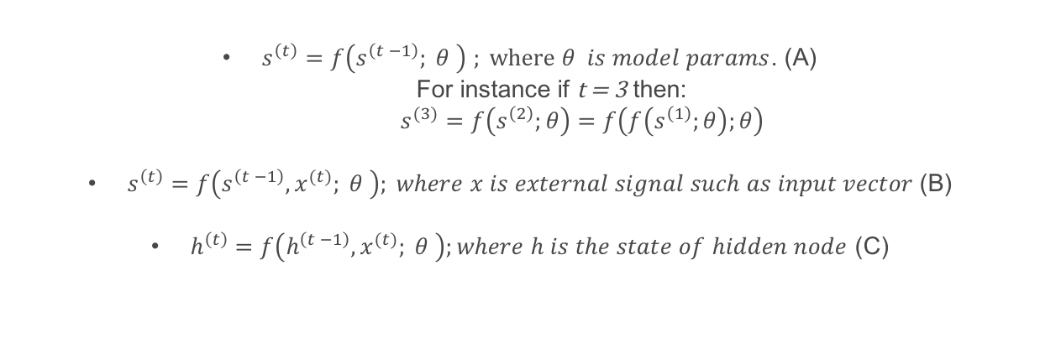
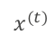
Unfolding Computational Graph
$s^{\left(t\right)}=f\left(s^{\left(t −1\right)}; θ \right)$ $; where θ is model params$. (A)
For instance if t = 3 then:
$s^{(3)}=f\left(s^{\left(2\right)};θ\right)=f\left(f\left(s^{\left(1\right)};θ\right);θ\right)$
$s^{\left(t\right)}=f\left(s^{\left(t −1\right)}, x^{(t)}; θ \right); where x is external signal such as input vector$(B)
$h^{\left(t\right)}=f\left(h^{\left(t −1\right)}, x^{(t)}; θ \right);where h is the state of hidden node$ (C)
h
$$h^{(…)}$$
$$h^{(t−1)}$$
$$t^{(t)}$$
$$h^{(t+1)}$$
$$h^{(…)}$$
$$f$$
$$f$$
$$f$$
Unfold
x
$$x^{(t−1)}$$
$$x^{(t)}$$
$$x^{(t+1)}$$
http://www.deeplearningbook.org/

Slide 30
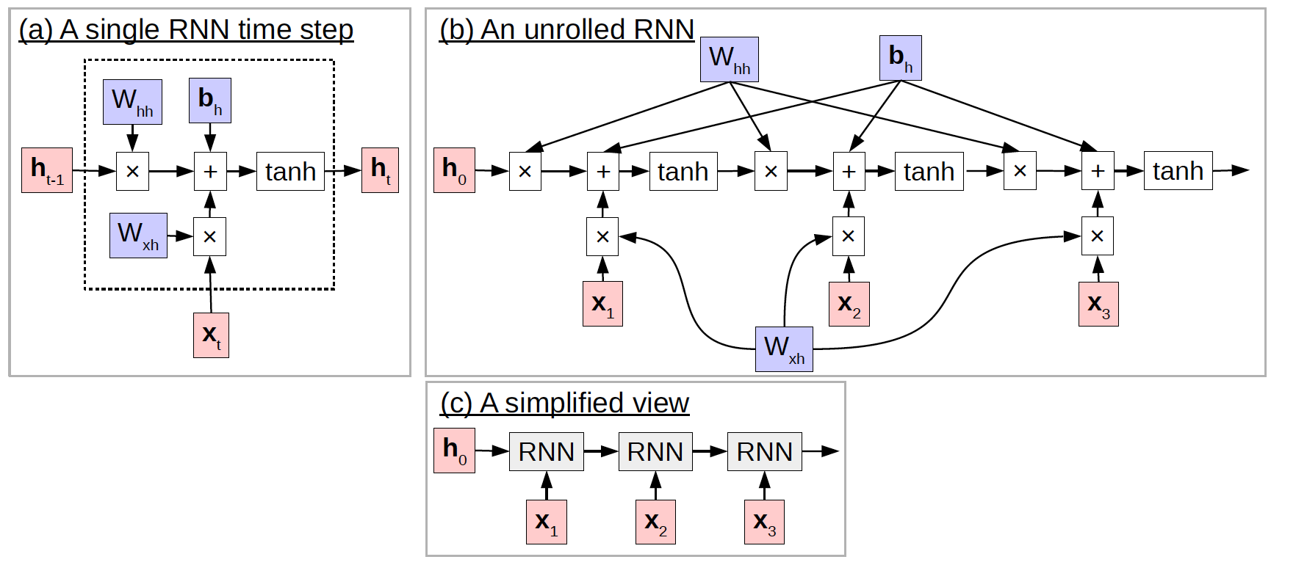
RNN Unrolling Through Time

Slide 31
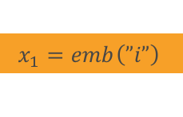

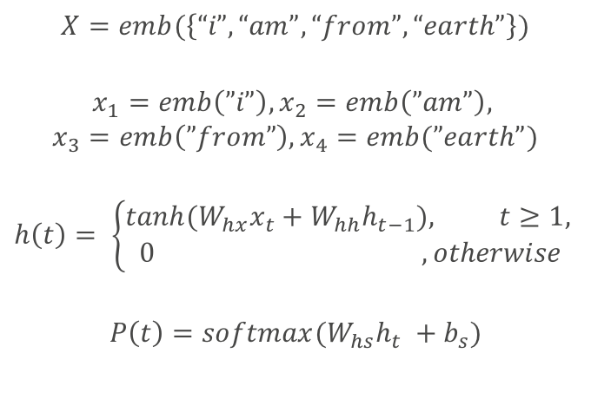
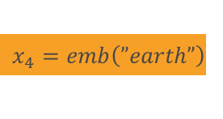
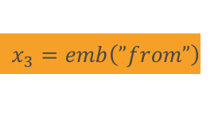
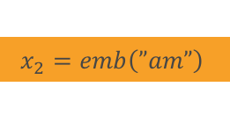
RNN Unrolling - Example
$$X=emb(\left\{“i”, “am”, “from”, “earth”\right\})$$
$$x_{1}=emb\left(”i”\right), x_{2}=emb\left(”am”\right),$$
$$x_{3}=emb\left(”from”\right), x_{4}=emb(”earth”)$$
$$h\left(t\right)= \left\{\begin{aligned}tanh⁡(W_{hx}x_{t}+W_{hh}h_{t−1}), t≥1, \\ 0 , otherwise\end{aligned}\right.$$
$$P\left(t\right)=softmax(W_{hs}h_{t} +b_{s})$$
0
RNN
RNN
$$x_{1}=emb\left(”i”\right)$$
$$x_{2}=emb\left(”am”\right)$$
RNN
RNN
$$x_{4}=emb\left(”earth”\right)$$
$$x_{3}=emb\left(”from”\right)$$
softmax
$$y$$

Slide 32
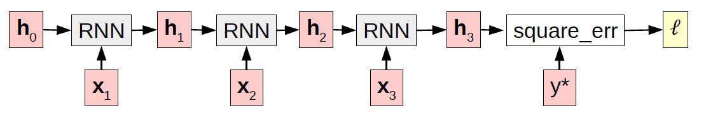
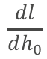
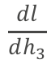
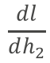
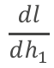
Training RNN Networks
Unrolling in time makes the turns the training task into a feed-forward network.
Since RNN represents a dynamical system we carry weight matrices along the time steps.
$$\frac{dl}{dh_{0}}$$
$$\frac{dl}{dh_{1}}$$
$$\frac{dl}{dh_{2}}$$
$$\frac{dl}{dh_{3}}$$

Slide 33
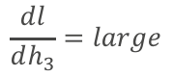
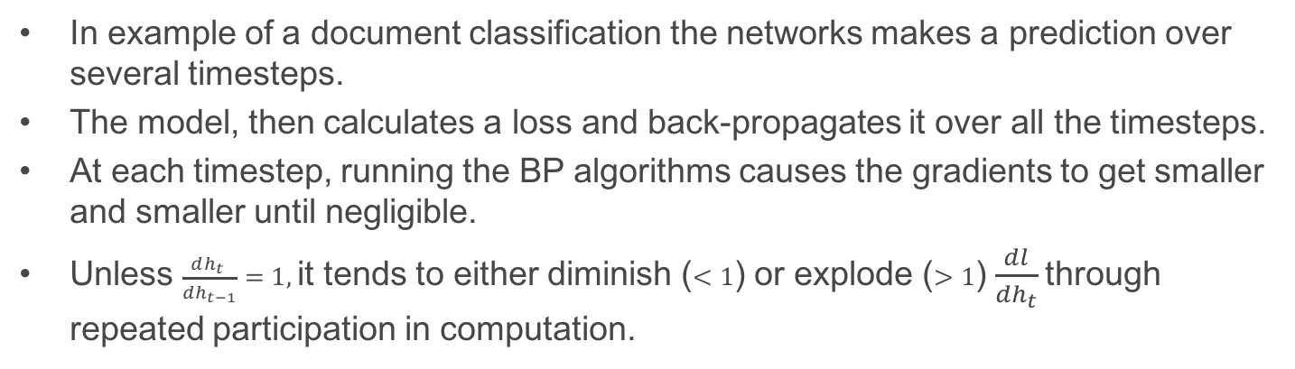
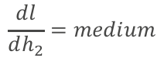


Vanishing & Exploding Gradients
$$\frac{dl}{dh_{0}}=tiny$$
$$\frac{dl}{dh_{1}}=small$$
$$\frac{dl}{dh_{2}}=medium$$
$$\frac{dl}{dh_{3}}=large$$
In example of a document classification the networks makes a prediction over several timesteps.
The model, then calculates a loss and back-propagates it over all the timesteps.
At each timestep, running the BP algorithms causes the gradients to get smaller and smaller until negligible.
Unless $\frac{dh_{t} }{dh_{t−1}}=1,$it tends to either diminish ($<1$) or explode ($>1$) $\frac{dl}{dh_{t}}$through repeated participation in computation.

Slide 34



Vanishing and Exploding Gradients; the math
$$\text{Multipying} \text{weight} \text{Matix} \text{W}\text{ , }\text{t} \text{times} \text{to} \text{rech} \text{time}\text{−}\text{step} \text{t} →W^{t}$$
$$Suppose W has decomposition W= Vdiag\left(λ\right)$$
$$W^{t}={\left(Vdiag\left(λ\right)V^{−1}\right)}^{t}=\left(Vdiag{\left(λ\right)}^{t}{ V}^{−1}\right)$$
$$When λ≠1 W can become too large or too small.$$
More specially in RNNs
$$h^{t}=W^{T}h^{\left(t−1\right) }$$
$$h^{\left(t\right)}={\left(W^{t}\right)}^{T}h^{\left(0\right)}$$
$$If W admits eigendecomposition QΛQ^{T }$$
$$∴ h^{\left(t\right)}= Q^{T}Λ^{t}Qh^{(0)}$$
If $Λ≠I_{t }=diag{\left(1, 1, …,1\right)}_{n}$ then the gradients can diminish or explode.
http://www.deeplearningbook.org/

Slide 35
Long Short Term Memory (LSTM)

Slide 36


LSTM
To resolve the vanishing gradient problem we want to design a network that ensures derivative of recurrent function is exactly 1.
The idea behind LSTM is to add a gated memory cell c to hidden nodes for which $\frac{dc_{t} }{dc_{t−1}}$ is exactly 1.
Since derivative of the recurrent function applied to memory cell is exactly one, the value inside the cell does not suffer from vanishing gradient.
Picture from Alex Grave PHD Thesis

Slide 37





LSTM Cell– The Anatomy
Output gate (sigmoid) controls
the output’s contribution
1
Linear self-loop
Forget gate (sigmoid) controls
The value of state self-loop
0
$$σ(x)=\frac{1}{1−e^{−x}}$$
Input gate (non-linear) controls
the input
$$tanh(x){=\frac{2}{1+e^{−2x}}−1 }$$

Slide 38


LSTM Cell– Input and Output Gates
“gates” either allow information to pass or block it.
Gate functions perform an affine transform followed by the sigmoid function, which squashes the input between 0 and 1.
The output of the sigmoid is then used to perform a componentwise multiplication. This results in the “gating" effect:
if $σ≃1⇒gate is open:$ it will have little effect on the input.
if $σ≃0⇒gate is closed:$it will block the input.

Slide 39



LSTM; the math
How Much to update?
Gate Functions
$$\frac{dc_{t}}{dc_{t−1}}= \frac{d(i_{t}⊙u_{t}+c_{t−1})}{dc_{t−1}}=0+1=1$$
Calculating the Next Hidden State; used in probability calculation of lang. model:
$$p_{t}=softmax(W_{hs}h_{t}+b_{s})$$
This is the main goal of LSTM to avoid vanishing or exploding gradients

Slide 40

Adding Forget Gate
In most common variant of LSTM, a forget gate is added, so that the value of memory can be reset. We often would like to forget memory cell values after making an inference and no longer need the long term dependencies.
Often a large bias to prevent the network from forgetting everything.
Modulating c_{t} with f_{t} enables the network to easily clear it memory when justified by setting f-gate to 0.

Slide 41

Handwriting Recognition by Alex Graves

Slide 42


Stacking RNNs
Like all types of ANN, one can stack RNNs in order to detect more abstract features such as part of speech or tense.
Stacking can however cause vanishing gradients in vertical direction.
An easy solution is residual networks in which we add output of the previous layer to the next layer.

Slide 43
Encoder-Decoder Models

Slide 44
Problems of Translation
To perform translation we need to solve blow problems:
Modeling: First, we need to decide what our model $P\left(E | F;θ\right)$will look like. What parameters will it have, and how will the parameters specify a probability distribution?
Learning: Learning: Next, we need a method to learn appropriate values for parameters from training data.
Search: Finally, we need to solve the problem of finding the most probable sentence (solving “argmax"). This process of searching for the best hypothesis and is often called decoding.

Slide 45


Translation: Inferring a Sequence from another
We still intend to calculate $P(E;θ)$, but before doing so we would like to calculate the initial state of the target model based on another RNN over the surce sentence $F$.
First RNN ”encodes” source sentence $F$, and second RNN “decodes” the initial state into target sentence $E.$
http://opennmt.net/

Slide 46



Encode-Decoder Models

Slide 47

Generating Output
So far we have seen how to make a probability model. In order to perform translation, we need to generate output. Generally this is performed using search in parallel corpora, the corpora of target language.
Search is performed based on several Criteria:
Random Sampling: Randomly selecting an output E from a probability model. $\hat{E} \sim P(E|F)$
Greedy 1-Best Search: Finding E that maximizes $P\left(E | F\right); \hat{E}=argmax_{E} P \left(E|F\right)$
Beam Search: Finding the n options with the highest probability $P \left(E|F\right)$

Slide 48




Random Sampling
The method is used when we would like to find several outputs for an input such as dialog models in chat bots.
Ancestral Sampling: Sampling variable values one at a time and gradually conditioning to more context.
The method is unbiased, but has high variance and is inefficient.
$Assume F represents X=\left\{“the”, “actor”, “walked”, “onto”,”the”, “stage”, “.”, <eos>\right\}$
$at time step t sample a word from distribution P\left(e_{t}\right|{\hat{e}}_{1}^{t−1}) until x_{i}=<eos>$
the
actor
walked
onto
…
the|F
actor|the
Walked|the, actor
RNN: F
$$h_{0}^{e}$$
$$h_{1}^{e}$$
$$h_{1}^{e}$$

Slide 49

Greedy 1-Best Search
This is very similar to random sampling with one difference: The goal is to search for the word in target corpora that maximized probability; ${\hat{e}}_{t}^{}=argmax_{i} log⁡(p_{t, i}^{\left(e\right)})$
Greedy search is not guaranteed to find the translation with highest probability, but is efficient in terms of memory and computation.
https://github.com/tensorflow/nmt

Slide 50

Beam Search
Beam Search is a search method that searched for b best hypothesis at each time step. b is called width of the beam.
Larger beam size has a strong length bias.
b is a hyperparameter that should be selected to maximize accuracy.
Not very efficient.

Slide 51
Attentional NMT

Slide 52
Limitation of Encoder-Decoder
He purchased a car, so that he could drive to work and not spend his time on train.
Long distance dependencies between words that need to be translated to each other
Storing information of sentences of arbitrary length in the same fixed-length vector.
Small model cannot store information about long sentences.
Large model is inefficient for small sentences.
Increasing number of parameters makes is difficult to train the model.
Er kaufte ein Auto, damit er zur Arbeit fahren und seine Zeit nicht im Zug verbringen konnte

Slide 53
Attention
The attention model comes between the encoder and the decoder and helps the decoder to pick only the encoded inputs that are important for each step of the decoding process.
For each encoded input from the encoder RNN, the attention mechanism calculates its importance:
https://talbaumel.github.io/attention/

Slide 54

Attention – Visualization of Importance
https://aws.amazon.com/blogs/ai/amazon-at-wmt-improving-machine-translation-with-user-feedback/

Slide 55


Attention Mechanism
The attention computation happens at every decoder time step. It consists of the following stages:
The current target hidden state is compared with all source states to derive attention weights
Based on the attention weights we compute a context vector as the weighted average of the source states.
Combine the context vector with the current target hidden state to yield the final attention vector
The attention vector is fed as an input to the next time step (input feeding). The first three steps can be summarized by the equations below:
$$α_{ts}:attention weights$$
$$c_{t}:context vector$$
$$α_{t}=attention vectorl$$

Slide 56

Attention Mechanism
https://aws.amazon.com/blogs/ai/train-neural-machine-translation-models-with-sockeye/

Slide 57

Calculating Attention Score
Method | Pros | Cons | Formula
Dot Product | Simple No additional Parameters | Input and output encoding in the same space | attn_score $\left(h_{j}^{\left(f\right)},h_{t}^{\left(e\right)}\right):=h_{j}^{{\left(f\right)}_{T}}h_{t}^{\left(e\right)}$
Bilinear Functions | Input and output of different sized | More expensive than $⊗$ | attn_score $\left(h_{j}^{\left(f\right)},h_{t}^{\left(e\right)}\right):=h_{j}^{{\left(f\right)}_{T}}W_{a}h_{t}^{\left(e\right)}$ $$W_{a }is a linear transformation$$
MLP | More flexible than $⊗$ Fewer parameters than BLF |  | attn_score $\left(h_{j}^{\left(f\right)},h_{t}^{\left(e\right)}\right)≔w_{a2}^{T}\tanh\left(W_{a1}[h_{t}^{\left(e\right)};h_{j}^{\left(f\right)}]\right)$ $$W_{a1}and w_{a2} are weight matrix and vector of \\ the first and second layers of the MLP \\ respectively$$

Slide 58

Measuring Translation Performance
BLEU: The BLEU score measures similarity to human translation. It measures how many words overlap in a given translation when compared to a reference translation. BLEU scores range from 0-100, the higher the score, the more the translation correlates to a human translation.
TER: The TER score measures the amount of editing that a translator would have to perform to change a translation so it exactly matches a reference translation. By repeating this analysis on a large number of sample translations, it is possible to estimate the post-editing effort required for a project. TER scores also range from 0-100.

Slide 59


Slide 60




AWS Deep Learning Infrastructure Tools
Deep Learning AMI,
Preconfigured for Deep Learning
mxnet, TensorFlow, …
P2 Instances:
Up to 40K CUDA Cores
CFM Template
Deep Learning Cluster

Slide 61

Apache MXNet
Most Open
Best On AWS
Accepted into the Apache Incubator
Optimized for deep learning on AWS

Slide 62
Amazon AI: Scaling With MXNet
88%
Efficiency
Ideal
Inception v3
Resnet
Alexnet

Slide 63
Sockeye Encode-Decoder Framework
Sockeye is a a sequence-to-sequence framework for Neural Machine Translation based on Apache MXNet Incubating. It implements the well-known encoder-decoder architecture with attention.
Github repo: https://github.com/awslabs/sockeye
Tutorials: https://github.com/awslabs/sockeye/tree/master/tutorials
python3 -m sockeye.train -s train.source \ -t train.target \ -vs dev.source \ -vt dev.target \ --num-embed 32 \ --rnn-num-hidden 64 \ --attention-type dot \ --use-cpu \ --metrics perplexity accuracy \ --max-num-checkpoint-not-improved 3 \ -o seqcopy_model
python -m sockeye.translate -m seqcopy_model

Slide 64
Sockeye Features
Beam search inference
Easy ensembling of multiple models
Residual connections between RNN layers (Wu et al., 2016)
Lexical biasing of output layer predictions (Arthur et al., 2016)
Modeling coverage (Tu et al., 2016)
Context gating (Tu et al., 2017)
Cross-entropy label smoothing (e.g., Pereyra et al., 2017)
Layer normalization (Ba et al, 2016)
Multiple supported attention mechanisms
Multiple model architectures(Encoder-Decoder Wu et al., 2016, Convolutional Gehring et al, 2017, Transformer Vaswani et al, 2017,)

Slide 65


Sockeye on Multiple GPUs
Training can be carried out on multiple GPUs by either specifying multiple GPU device ids: --device-ids 0 1 2 3, or specifying the number GPUs required: --device-ids -n attempts to acquire n GPUs.

Slide 66


Slide 67
References
arXiv:1703.01619v1 [cs.CL] 5 Mar 2017: Neural Machine Translation and Sequence-to-sequence Models: A Tutorial. Graham Neubig, Language Technologies Institute, Carnegie Mellon University
All references and images are from arXiv:1703.01619v1 [cs.CL] 5 Mar 2017 unless directly referenced on the page.
Sockeye documentation: http://sockeye.readthedocs.io/en/latest/index.html

Slide 68
Cyrus M. Vahid
cyrusmv@amazon.com

